Slide 1
Cybersecurity
Driver Manipulation

Slide 2
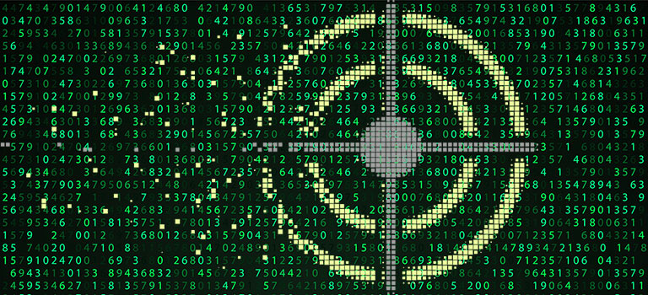
Hiding in plain sight
Signature – common behavior a virus has
Anti-virus and anti-malware programs work based on signatures
Checks known signatures
Reports or stops any code that matches
Important to keep signatures updated!

Slide 3

Drivers
Code between the hardware and your operating system
Trusted to simply do the job
Loads of security issues
Hardware interactions contain sensitive information
Video, Keyboard, Mouse, Network drivers

Slide 4
Driver Security Flaws
May 2016 – HP Audio Drivers
Conexant audio chips
Driver installation includes audio control software
Debugging feature enables a keylogger

Slide 5
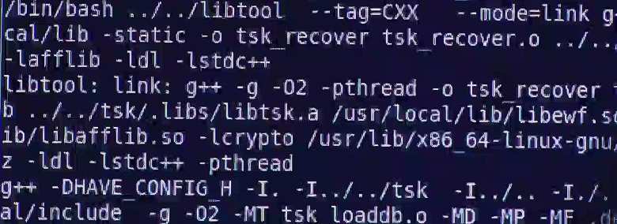
Shimming
Filling in the space between two objects
Windows includes it’s own shim
Backwards compatibility with previous Windows versions
Application Compatibility Shim Cache
Hackers can make their own shims
Get around security (like User Account Controls)
Inspect or Intercept data

Slide 6
Shimming Example
January 2015 Microsoft vulnerability
Elevates privilege

Slide 7

Refactoring
Malware that self-modifies
New program each time it runs
Creates different signature to hide from anti-virus and anti-malware
Add meaningless instructions
Loops, pointless code, obfuscation = different signature
Can intelligently redesign itself
Changes up order of code (ex: 2x3x4 = 2x4x3 = 3x2x4 - different steps, same outcome)
Generate unused data types
Use different amounts of memory at varying times
Difficult to match with normal signature-based detection

